Slide 1
Intro to Computer Networks

Slide 2
4 Layer Internet Model
Application Layer
Applications reuse the same building blocks for transmitting data
The internet is made up of end hosts, links and routers
The 4 Layer Internet Model is used to describe the operations that make up the internet
Transport Layer
Network Layer
Link Layer

Slide 3
4 Layer Internet Model - Link Layer
Application Layer
Transport Layer
Network Layer
Link Layer

Slide 4
4 Layer Internet Model - Link Layer
End Host
Link
Link
Link
End Host
Router
Router
Packets consist of the data to be delivered and a header with information about the data.
The link layer is responsible for carrying data packets across one link at a time.
Examples of link layer protocols are Ethernet and Wifi (802.11).

Slide 5
4 Layer Internet Model - Network Layer
Application Layer
Transport Layer
Network Layer
Link Layer

Slide 6
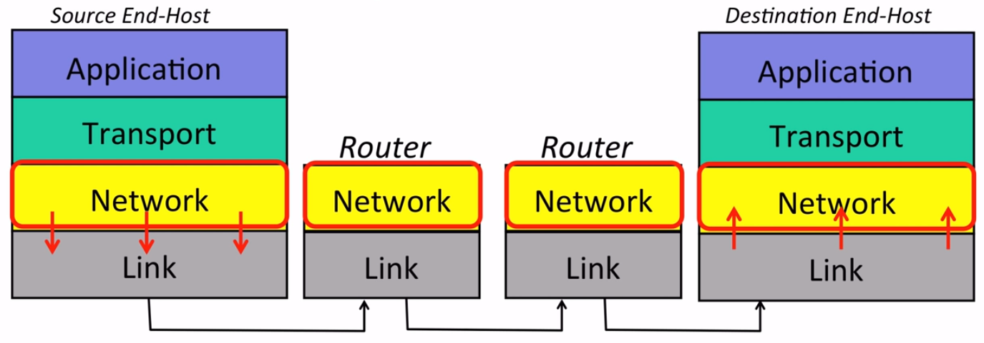
4 Layer Internet Model - Network Layer
The Network Layer is responsible for delivering packets end to end from the source to the destination.
Network Layer packets are called datagrams.
Examines the datagram and sends it one link at a time to its destination, without having to worry about how the link works.
Restricted to using the Internet Protocol (IP).
Image source: Levis, Nick and Nick McKeown. Introduction to Computer Networking. Stanford University, March 2015, https://lagunita.stanford.edu/courses/Engineering/Networking-SP/SelfPaced.

Slide 7
4 Layer Internet Model - Transport Layer
Application Layer
The Transport Layer ensures that the data sent by one application is correctly delivered to another.
TCP (Transmission Control Protocol) guarantees correct, in order delivery of data and provides reliability.
UDP is simpler and offers no delivery guarantees.
Transport Layer
Network Layer
Link Layer

Slide 8




4 Layer Internet Model - Application Layer
Application Layer
The Application Layer sends data directly to its peer application at the destination
Does not worry about how data is delivered
Transport Layer
Network Layer
Link Layer

Slide 9
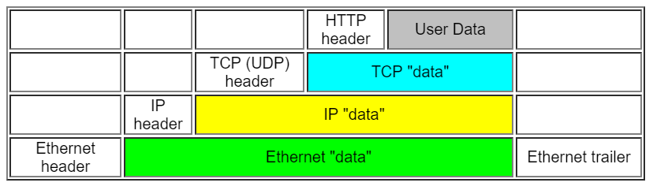
4 Layer Internet Model
Each layer communicates with its adjoining layers, without regard to how the other layers communicate information.
Headers are concatenated to the beginning of the packet before the data is then delivered across the internet
Image source: Taylor, Nolan. The Data Link Layer..The Indiana University Kelley School of Business, May 2009, http://home.kelley.iupui.edu/notaylor/S305/labs/datalink.htm.

Slide 10
Domain Name System (DNS)
Domain Names
IP Addresses
DNS is a service that maps domain names to IP addresses
The system must be able to map names to addresses, handle a huge number of records, have distributed control, and be able to handle individual node failures
Used when browsing to different domains on the world wide web
www.uwaterloo.ca
129.97.208.23
facebook.com
157.240.2.35
docs.google.com
109.233.56.78
ctftime.org
172.217.1.174

Slide 11
Domain Name System (DNS)
edu
google
drive
DNS Servers are structured into hierarchies to allow distributed control
Structure goes from root -> Top Level Domains -> Domains
Each zone of domain names can be separately administered.
Servers can be replicated (can have multiple servers responding to queries for same domain)
maps
com
netflix
root
yahoo
ctf
ca
uwaterloo
cs
student
www
org
www

Slide 12
Domain Name System (DNS)
Clients perform recursive queries to DNS resolvers which returns the desired IP address
Resolvers perform non-recursive queries to DNS servers which return results one step at a time
Resolvers cache results to increase efficiency of future queries
See the following slide for a visual representation of a DNS Query

Slide 13
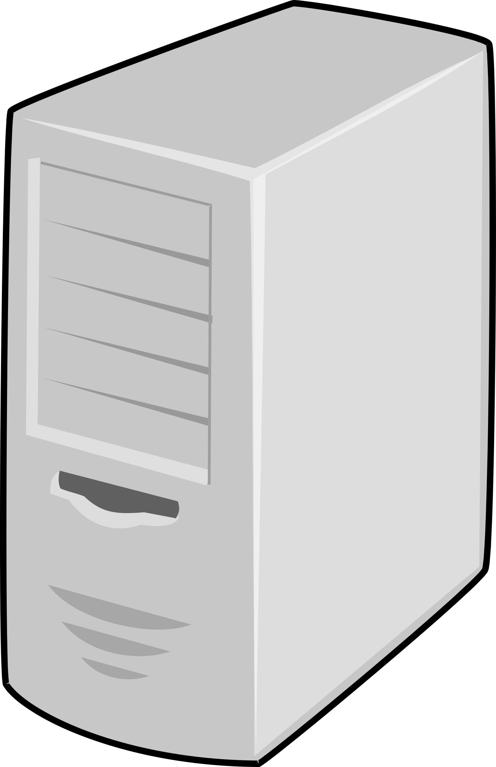
Domain Name System (DNS)
Root
Top Level Domain
uwaterloo?
ca?
x.x.x.x
Domain
Client
Resolver
x.x.x.x
cs.uwaterloo.ca?
cs.uwaterloo.ca?
129.97.173.41
129.97.173.41

Slide 14
Transport Layer - TCP
Most commonly used transport protocol: TCP (Transmission Control Protocol)
Provides a reliable, end-to-end, bidirectional byte stream service
TCP Properties:
Acknowledgements to indicate that data has been delivered
Checksums to detect corrupt data
Sequence numbers to detect missing data
Flow-control to prevent overrunning the receiver
Data is delivered to the application in the sequence that is was transmitted.

Slide 15
Transport Layer - TCP
SYN
TCP Connection Setup:
A sends SYN (synchronize) message to B
B acknowledges SYN message from A and sends back SYN message
A acknowledges SYN message from B
SYN, ACK
ACK
Host A
Host B

Slide 16
Transport Layer - TCP
TCP Connection Teardown:
A sends FIN message to B, indicating that A has no more data to send
B acknowledges FIN message from A (now has the decision to keep sending data or terminate connection by sending FIN message)
A acknowledges FIN message from B to terminate connection
FIN
ACK
FIN
ACK
Host A
Host B

Slide 17
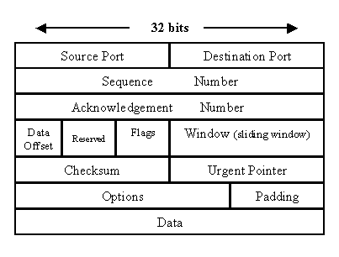
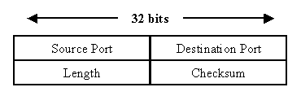
Transport Layer - TCP vs UDP
UDP Header
UDP (User Datagram Protocol)
Much simpler than TCP
Provides no connection
Provides no reliability
Lightweight and fast
Used with application that don’t need reliability (ie DNS, DHCP)
TCP Header

Slide 18
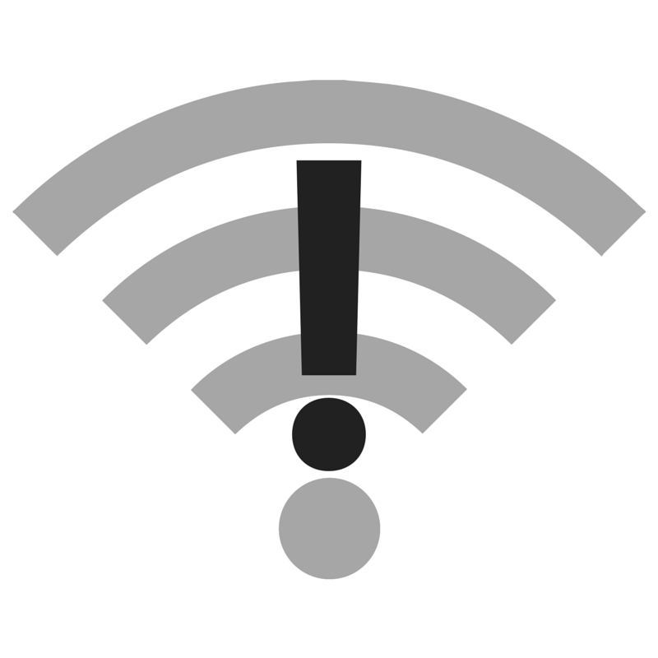
Transport Layer - ICMP
ICMP (Internet Control Message Protocol)
Communicates network layer information between hosts and routers
Reports error conditions and helps us diagnose network problems
Technically a transport layer protocol since it runs above the network layer
Provides no reliability (a simple service)
Relied on by command line tools like ping and traceroute

Slide 19
Network Layer
The Network Layer is responsible for delivering data end-to-end from source to destination
It is restricted to using the Internet Protocol (IP)
Image source: Levis, Nick and Nick McKeown. Introduction to Computer Networking. Stanford University, March 2015, https://lagunita.stanford.edu/courses/Engineering/Networking-SP/SelfPaced.

Slide 20
Layers - Recap
IP datagrams consist of a header and data
The transport layer hands a transport segment down to the network layer, which puts the transport segment into a new IP datagram
IP sends the datagram to the link layer to be sent off to the first router
Transport Layer
Packet
IP Header
Data
Link Layer
Header
Data

Slide 21
Internet Protocol
Source
Destination
The destination address in the IP header helps the router decide where to send the datagram next
The source address in the IP header lets the receiver know where to send a response
Datagrams are routed hop by hop from source to destination

Slide 22
Internet Protocol
Source
Destination
IP is unreliable and simple
Simplicity keeps the network minimal, fast, and easy to maintain
Reliably/unreliable services can be built on top of IP
The simple design allows IP to work over any link layer

Slide 23
Internet Protocol
Header Fields
TTL (Time To Live): prevents packets from looping forever
ID, Flags, Fragmentation Offset: IP fragments packets if they are too long for the link layer; these fields help the end host put them back together
Checksum: reduces chances of corrupt data and delivery to the wrong destination
Version: IPv4 or IPv6
Options: enable more functionality
IHL: Internet Header Length
Type-of-Service: how important the packet is
Protocol: what is inside the data field (ex: 6 for a TCP segment)
Version | IHL | Type-Of- Service | Total Length
Identification |  |  | Flags | Fragmentation Offset
Time-to- live | Protocol |  | Header Checksum
Source Address
Destination Address
Options
Data

Slide 24
IPv4 vs IPv6
IPv4:
32 bit long addresses, 4 groups of 8 bits
Not enough to keep up with the growth of the internet
IPv6:
128 bit long addresses, 8 groups of 18 bits
We are in the process of transitioning from IPv4 to IPv6
172.217.1.3
2607:f8b0:400b:80f::2003

Slide 25
6to4 IP Addresses
}
}
2002:**:**::
We can translate between IPv4 and IPv6 addresses using 6to4 addresses.
IPv4 Address
(Hexadecimal notation)
6to4 Prefix

Slide 26
IP Routing
Internet routers have many different links, so they use forwarding tables to decide where to send the data they are given
Forwarding tables consist of a set of partial IP addresses
Routers make decisions based off of the longest prefix match (LPM) algorithm
The algorithm chooses the most specific address in the forwarding table that matches the IP header’s destination address
Example: 23.33.5.5 would go to link 4
23.128.3.0 would go to link 3
179.5.4.2 would go to link 1
Forwarding Table
x.x.x.x | 1
171.33.x.x | 2
23.x.x.x | 3
23.33.5.x | 4
171.32.x.x | 5

Slide 27
Subnet Masks
216.3.128.12 → 11011000.00000011.10000000.00001100
255.255.255.0 → 11111111.11111111.11111111.00000000
-----------------------------------
216.3.128.0 ← 11011000.00000011.10000000.00000000
A subnet is an organization of connected network devices
Subnet masks separate the IP address into 2 components: the network and the host addresses
We can calculate the network address by performing bitwise AND operations
In the example above, 216.3.128.12 is the IP address, 255.255.255.0 is the subnet mask, and 216.3.128.0 is the network address.

Slide 28
Why Subnet?
Web Host Network Address: 216.3.128.0
216.3.128.(0000 0000) (1st half assigned to the web host) 216.3.128.(1000 0000) (2nd half assigned to the customers)
We can use subnetting to divide networks into multiple parts
Every time a network is divide into 2 subnets, we lose the ability to use 2 addresses since one must correspond to the network IP and one must correspond to the broadcast IP.

Slide 29
Classless InterDomain Routing (CIDR)
Class A
Subnet Mask: 255.0.0.0
Class B
Subnet Mask: 255.255.0.0
Class C
Subnet Mask: 255.255.255.0
Web Host Address: 216.3.128.0(/25) <- CIDR notation
IP addresses were originally assigned using classes (A-D)
Each class corresponds to a size of a block of addresses
This was wasteful so we’ve begun using Classless InterDomain Routing
We can represent addresses with their subnet masks in CIDR notation
The number next to the slash indicates the number of bits assigned to the network address

Slide 30
Link Layer
1 0 1 0 1 0 1 1 0 1 1 0 0 1 1 0 1 1 0 0 0 1 0 1 0 0
Router
Router
The Link Layer is responsible for delivering frames across links between an end host and a router or two routers
Its key functions are Medium Access Control (MAC), error detection and correction, and message delineation
Data is translated to bits before being sent across the link

Slide 31
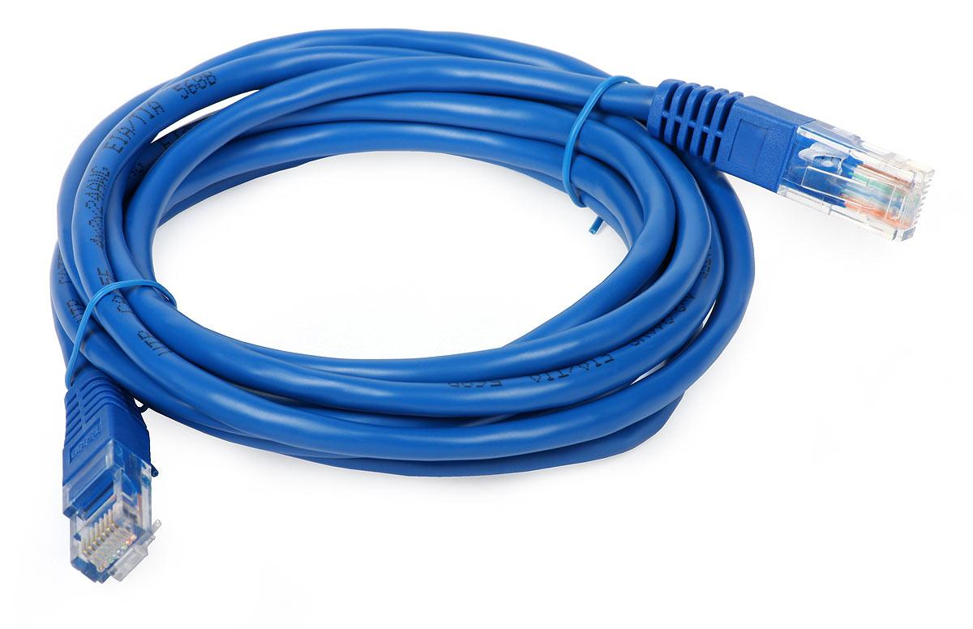
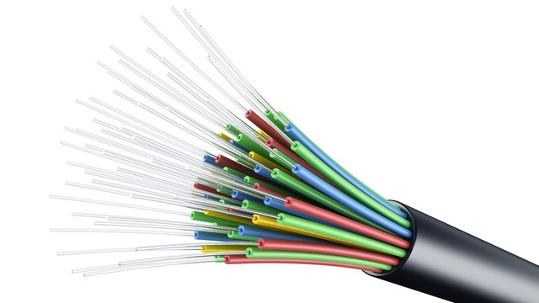
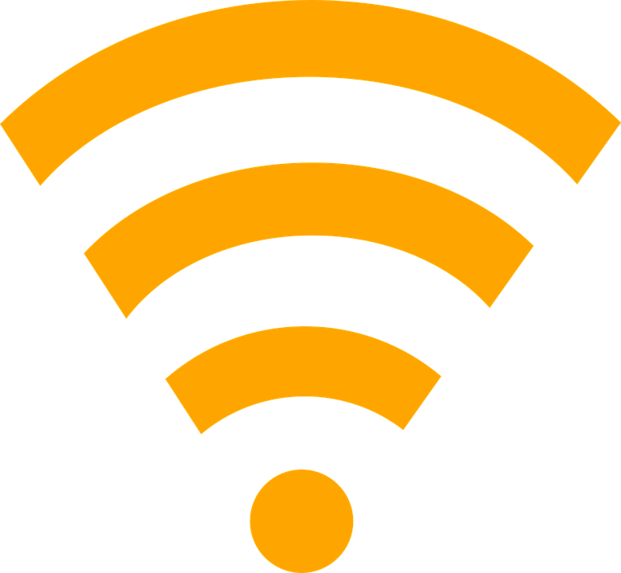
Link Layer
Methods of data transfer:
Electricity
Data can be transmitted using pulses of electricity through copper wire
Signal is lost over long distances
Cheap method of data transfer
Light
Data can be transmitted by bounding light up and down the length of fiber optic cables
No signal loss (this method is used for long distances) and very fast (travels at the speed of light)
Very expensive
Radio Waves
Wireless mediums use radio waves of different frequencies
Signal loss occurs over long distances

Slide 32
Message Delineation
0
1
1
0
1
0
0
1
0
Data
Sender’s Clock
Receiver’s Clock
Message Delineation is figuring out where a message starts and where it ends
If the receiver is accepting data at a slower rate than the sender is sending it, errors occur
Routers have clock recovery units to sync up their rates of data transmission to ensure that all data is properly received

Slide 33
Message Delineation - Manchester Encoding
0
1
1
0
1
0
0
1
0
Data
Manchester Encoding
Manchester Encoding:
Use one transition for every bit of data (0 = transition down, 1 = transition up)
Receiver will be able to match up their clock with the rate at which it sees transitions
Disadvantage: we insert more transitions than we really need. In the worst case, we are doubling bandwidth

Slide 34
Message Delineation - 4b/5b Encoding
Data | 4b/5b
0000 | 11110
0001 | 01001
0010 | 10100
0011 | 10101
... | ...
4b/5b Encoding
If we have 4 bits of data to transmit, send 5 instead
Choose a sequence of 5 bits that has enough transitions for the receiver to tell what clock is being used
Sender and receiver have an agreed upon mapping of 4 to 5 bit pairs
More efficient than Manchester coding
Fewer transitions makes the clock recovery more difficult

Slide 35
Medium Access Control (MAC)
We often have multiple hosts sharing a medium (cable, air space, etc.), so the Link Layer has to decide who gets to send data and when
Goal of Medium Access Control (MAC) Protocols is to allow high usage of a shared channel, keep it fair among host, have a simple and low cost of implementation, and remain robust to errors
Notes:
Aloha protocol
Have data to send? Transmit it
If it “collides” with another, try again later
If there’s not a lot of activity, this works pretty well, but if the wire is busy, then this isn’t very efficient
CSMA/CD Protocol (Carrier-Sense Multiple Access with Collision Detection)
Check that the line is quiet before transmitting
If a collision is detected, then the host will stop transmitting, wait a random amount of time
Repeat
Error Detection
Link Layer is prone to a lot of collisions and errors.
Adding some redundancy at the physical layer can greatly improve the link layer’s ability to transmit data correctly
Coding Algorithms: Reed-Solomon, Convolutional codes, Hamming codes
Proactively add some additional data so that the receiver can correct potential errors

Slide 36
Medium Access Control (MAC)
Aloha Protocol
Have data to send? Transmit it
If it collides with another, try again later
CSMA/CD Protocol
Check that the line is quiet before transmitting
If a collision is detected, stop transmitting, wait a random amount of time, and repeat from beginning

Slide 37
Error Detection and Correction
The Link Layer is prone to a lot of collisions and errors since data is sent over cables and through waves.
Adding some redundancy at the physical layer can greatly improve the link layer’s ability to transmit data correctly
Examples of Coding Algorithms: Reed-Solomon, Convolutional codes, Hamming codes
These algorithms proactively add additional data so that the receiver can correct potential errors

Slide 38
Ethernet
Preamble SFD DA SA Type Data Pad CRC
Ethernet Frame Format
Preamble: trains the clock recovery unit
SFD (Start of Frame Delimiter): indicates the start of the frame
Destination Address/Source Address: physical addresses
Type: what data is being transmitted
Pad: to ensure the frame is of proper length
CRC (Cyclic Redundancy Check): checks sequence to detect bit errors

Slide 39
Ethernet
Ethernet Switch
Ethernet switches are located in the centre of a network and are used to route data from one host to another within the network, while preventing collisions
Forwarding: the switch forwards packets based on a forwarding table. If the destination address is in the table, send to that address. Otherwise, broadcast to all hosts
Learning: the switch examines the source addresses of arriving traffic to populate the forwarding table

